Slide 1
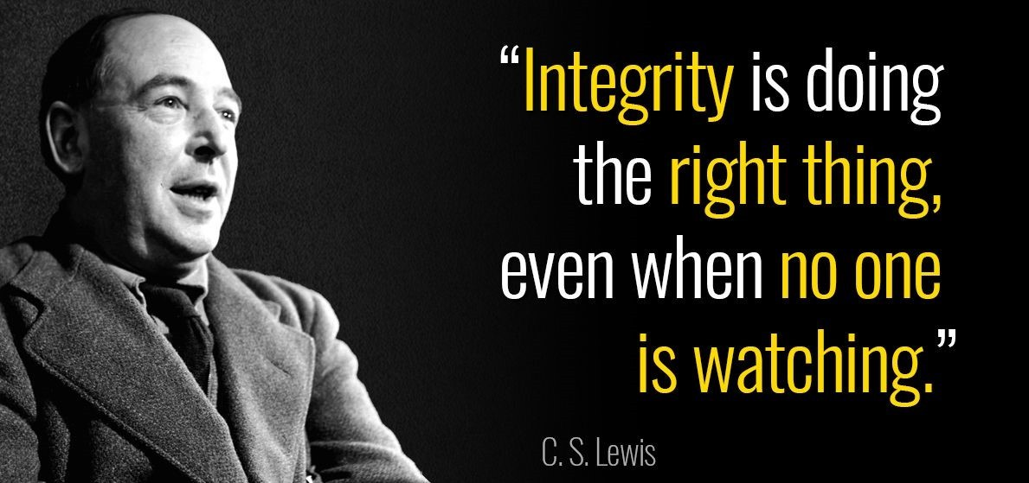
Notes:
But isn’t it more difficult to do the right thing when all those with vested interests are watching? Next slide: COIs
Three basic situations:
No one is watching
Everyone is watching (uninterestedly)
Stakeholders with conflicts of interest are watching

Slide 2
Making mistakes while everyone is watching
Gerben ter Riet, MD PhD
Amsterdam University Applied Sciences, Faculty of Health
g.ter.riet@hva.nl
https://orcid.org/0000-0002-2231-7637
https://www.amsterdamuas.com/uv-openscience
Notes:
2nd School, Math, solving equations in front of everyone was scary

Slide 3
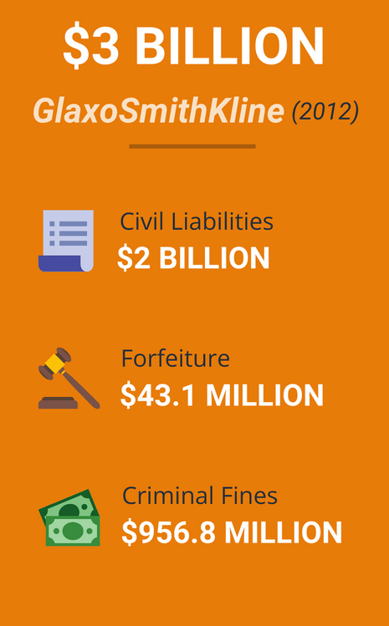
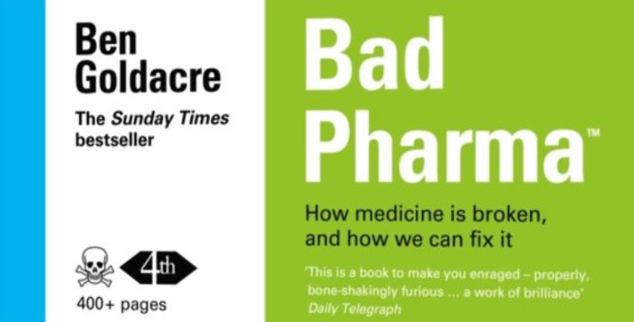
System flaws: Fox guarding the henhouse
Notes:
A drug company paid several millions for forfeiture, a fine. What does that mean? What did they do wrong? It typically means they have settled allegations of misconduct or violations of laws and regulations. The misconduct could relate to a variety of issues, including but not limited to:
1. Quality and Safety Violations:
Example: Failing to maintain adequate standards of quality and safety, leading to the distribution of contaminated or defective products.
2. Marketing and Promotion:
Example: Engaging in off-label marketing, or promoting drugs for uses that have not been approved by regulatory agencies such as the FDA (U.S. Food and Drug Administration).
3. Pricing and Billing:
Example: Overcharging government healthcare programs or patients, or engaging in price fixing.
4. Research and Development:
Example: Falsifying data or failing to disclose safety information during the drug approval process.
5. Manufacturing Practices:
Example: Violating Good Manufacturing Practices (GMP) regulations, resulting in substandard product quality.
6. Environmental Concerns:
Example: Improper disposal of waste or chemicals, causing environmental damage.
In these cases, the drug company may agree to pay a significant sum of money to settle the allegations without admitting guilt. These settlements often include a financial penalty intended to deter future misconduct and, in some cases, may require the company to implement corrective actions to address the underlying issues.
These fines can be imposed by various regulatory bodies depending on the country and the nature of the violation. In the United States, for example, the FDA, DOJ (Department of Justice), and EPA (Environmental Protection Agency) are among the entities that can impose such
and what about civil liabilities? What is meant by that in the case of drugs development?
Civil liabilities in the context of drug development refer to the legal responsibilities and consequences a pharmaceutical company faces in civil court, as opposed to criminal court. These can arise due to various reasons like manufacturing defects, inadequate warnings, design defects, or other issues leading to injury or harm. Here are some common scenarios:
1. Product Liability:
Example: If a drug causes unforeseen side effects or harms to patients, the company might face lawsuits for medical expenses, pain and suffering, lost wages, or other damages. The company is held liable for selling a defective or dangerous product.
2. Negligence:
Example: If the company failed to exercise reasonable care in the design, manufacturing, or distribution of the drug, and that failure resulted in harm.
3. Failure to Warn:
Example: If a drug company did not provide adequate warnings or instructions about the risks associated with the drug, and patients suffered as a result.
4. Fraudulent Misrepresentation:
Example: If a company falsely advertises or represents its drugs, causing harm or financial loss to patients or other stakeholders.
Financial Implications:
Pharmaceutical companies might need to compensate victims or pay punitive damages. They might also agree to settlements to resolve a multitude of lawsuits.
Operational Implications:
They might need to revise their warning labels, improve testing protocols, or even withdraw the drug from the market.
Reputation Implications:
The revelation of civil liabilities can damage the reputation of the drug company, affecting its stock price, customer trust, and future business.
These civil liabilities aim to compensate the victims and hold companies accountable for the safety and efficacy of their products. The civil liability cases are typically handled in civil courts and revolve around compensating victims rather than punishing the offenders (which is a focus in criminal cases).
These issues underscore the importance of rigorous clinical testing, ethical marketing, and thorough post-marketing surveillance to identify and mitigate risks associated with pharmaceuticals.

Slide 4
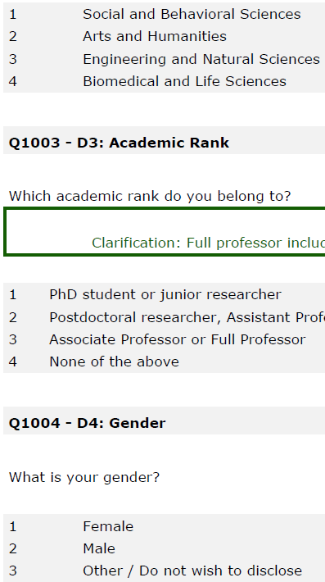
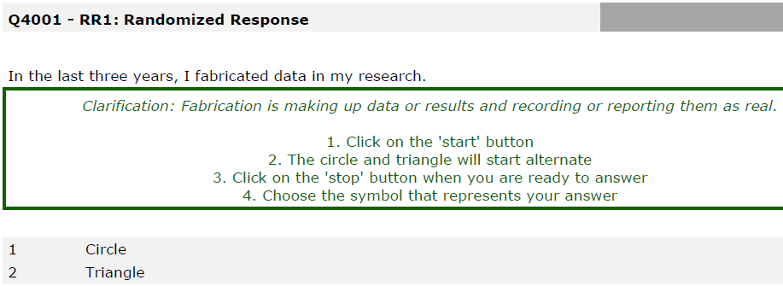
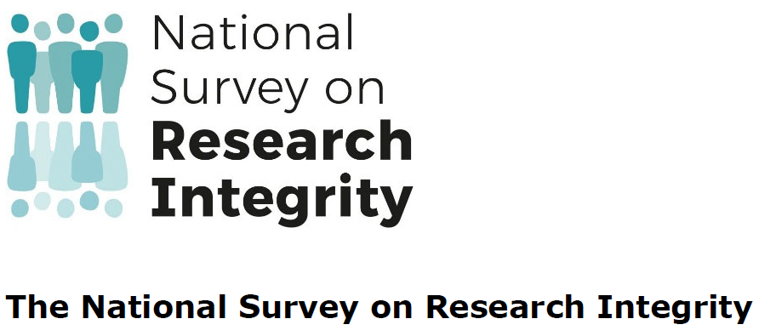
11 QRPs (don’t do it)
11 RRPs (do it)
2 FFs (sinful)
10 psychometric scales (explanatory)
Notes:
Many QRPs are prevalent because of ignorance or poor examples/education
Refs
1. https://f1000research.com/articles/11-471
2. https://journals.plos.org/plosone/article?id=10.1371/journal.pone.0263023

Slide 5
QRP/FF | Prevalence (%)
Any Frequent QRP (at least 1/11 QRPs with a score of 5,6,7) | 51.3
Fabrication (making up data or results) | 4.3
Falsification (manipulating research materials, data or results) | 4.2
Any FF (either fabrication or falsification or both) | 8.3
What is your estimate?
Notes:
QRP=questionable research practice (see slide 9)
RRP=responsible research practice (see slide 13)
RM = Research misconduct (see slides 11, 12)
11 QRPs were assessed on a 7-pointscale raging from 1 (never) to 7 (always) referring to the last 3 years.
Fabrication and Falsification was assessed by a dichotomous question (yes/no) referring to the last 3 years.
Gopalakrishna G, ter Riet G, Vink G, Stoop I, Wicherts J M, Bouter L. Prevalence of questionable research practices, research misconduct and their potential explanatory factors: a survey among academic researchers in The Netherlands. PLoS One 2022; 17: e0263023. https://journals.plos.org/plosone/article?id=10.1371/journal.pone.0263023

Slide 6
Open Access (read4free)
F.A.I.R. data (use again)
Citizen science (in all phases)
Transparency (enable replication)
Recognition & reward:
steer towards open science workstyles
Open science:
An umbrella concept
Notes:
https://link.springer.com/chapter/10.1007/978-3-319-00026-8_2

Slide 7
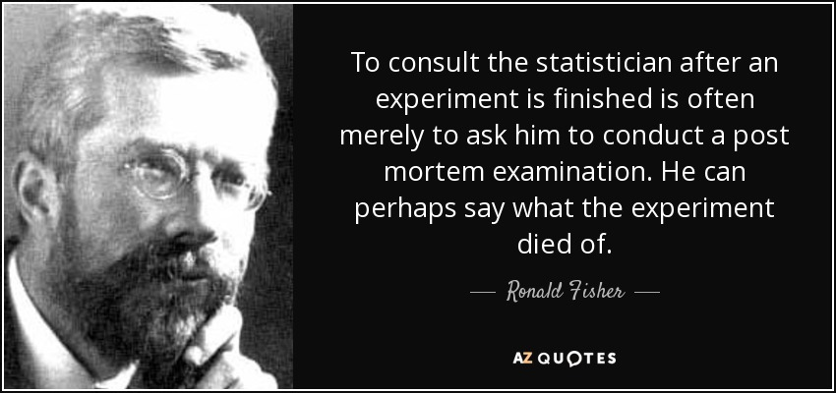
Notes:
Open Access and FAIR are effective (only) if questions, methods, analysis and reporting are adequate

Slide 9
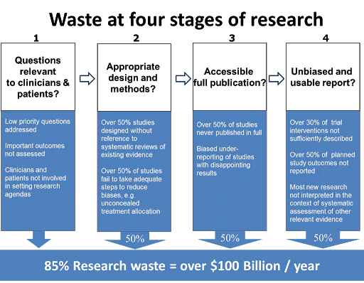
Notes:
See Lancet Jan 2014, Paul Glasziou and Iain Chalmers and Malcolm Macleod

Slide 10
Replication crisis
Notes:
See Brian Nosek, psychology reproducibility

Slide 11
Urban Vitality Open Science Checklist
Ensure privacy for participants
Consider ethics advice
Preregister protocol and (S)AP
Document your research
Report completely
Publish open access
Archive using FAIR principles
Get an ORCID
Justify relevance
Involve end-users
Consider reporting guidelines
Write detailed protocol
Write detailed analysis plan
Write data management plan
Notes:
https://doorwerking-hbo-onderzoek.nl/portfolio/open-science-checklist/ [in Dutch]
https://uvaauas.figshare.com/articles/online_resource/Open_science_checklist_Urban_Vitality/12213467
https://www.amsterdamuas.com/uv-openscience
https://hbo-kennisbank.nl/details/amsterdam_pure:oai:pure.hva.nl:publications%2F00c80703-c54b-4bf5-a3c5-bcc8f339995b?has-link=yes&q=support+desk

Slide 12
A handy checklist for transparent research
Notes:
Source: https://doorwerking-hbo-onderzoek.nl/portfolio/open-science-checklist/
https://uvaauas.figshare.com/articles/online_resource/Open_science_checklist_Urban_Vitality/12213467
https://www.amsterdamuas.com/uv-openscience
https://hbo-kennisbank.nl/details/amsterdam_pure:oai:pure.hva.nl:publications%2F00c80703-c54b-4bf5-a3c5-bcc8f339995b?has-link=yes&q=support+desk

Slide 13
Let’s
1. Invest in:
support staff for systematic reviews
methodologists, (bio)statisticians, data scientists
2. Explicitly recognize and reward transparent work styles
3. Sacrifice 1-2 chapters of dissertations to make the rest completely transparent (slow(er) science)
4. Stop putting too much emphasis on making immediate impact
5. Organize skepticism in our teams
Notes:
https://en.wikipedia.org/wiki/Mertonian_norms

Slide 14
Notes:
https://www.ncbi.nlm.nih.gov/pmc/articles/PMC10666927/pdf/elife-89736.pdf
https://www.nature.com/articles/d41586-020-02847-8

Slide 15
Notes:
https://www.nature.com/articles/d41586-020-02847-8

Slide 16
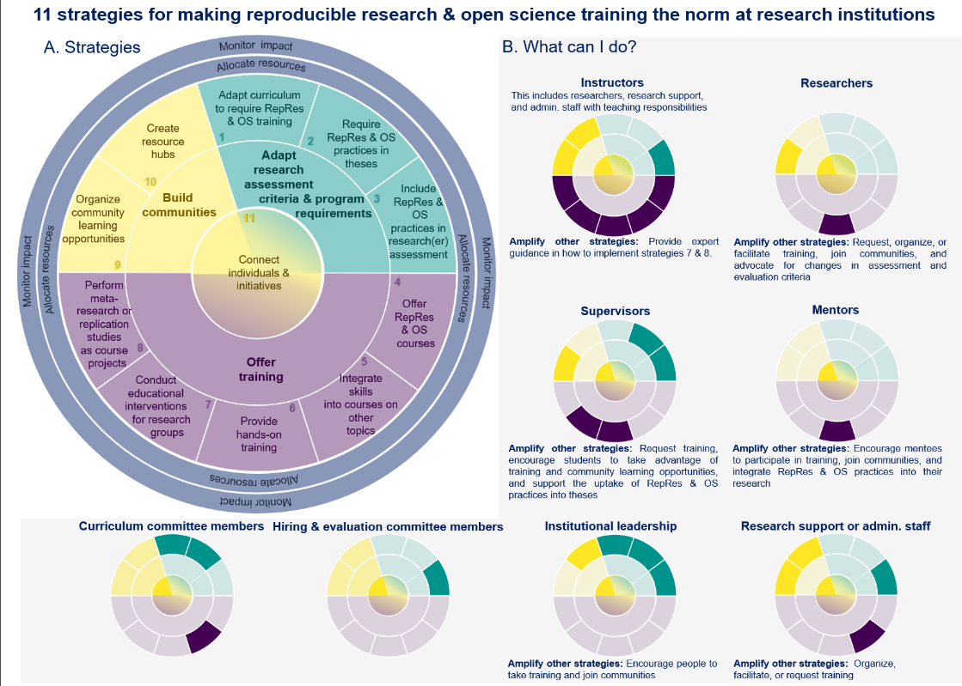
Notes:
https://www.ncbi.nlm.nih.gov/pmc/articles/PMC10666927/pdf/elife-89736.pdf

